Slide 1
Think Green Investing Project 2
Katharine Zenta, Amany El Gouhary Al Bakomito, Nicolas Hernandez

Slide 2
Project analysis slide 2
Agenda
PROJECT 1 RECAP
2. PROJECT 2
HYPOTHESIS
Think Green Investing
3. DATA DISCOVERY
AND ANALYSIS
4. ALGORITHMIC
TRADING & FINDINGS
MACHINE LEARNING
& FINDINGS
6. KEY TAKEAWAYS

Slide 3




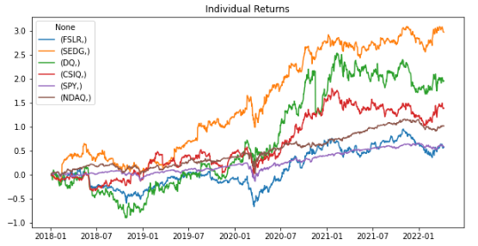
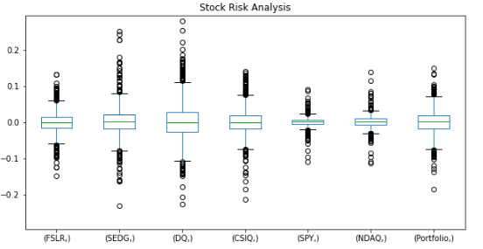
Project analysis slide 2
Project 1 Recap
SOLAR ENERGY STOCKS
Portfolio outperformed the market during all time frames analyzed
VOLATILITY
> volatility than SPY and NASDAQ but more profitable on risk-adj. basis.
CORRELATION
> correlated to SPY than NASDAQ – area to explore in next phase
COVID-19
Accelerated growth following markets recovery post Q1’20 – all stocks.

Slide 4

Project analysis slide 2
Project 2
Key Questions
Does our portfolio outperform S&P500(‘SPY’) using historical data ?
What other companies we can explore for the Portfolio?
Diversified wind and solar producer (and utility) in US mid-west. Inclusion of stocks across the value chain.

Slide 5


Project analysis slide 3
Data Discovery &
Analysis
Data Sourcing
Exploration
Algorithmic Trading
Machine Learning
Deployment
Function pulls daily closing prices for tickers in the given time period
Different timeframes for training and testing of models
Bollinger bands and RSI
Generate trading Signals
LSTM
30-day prediction
Deploy both Algorithmic Trading and ML code into a .py to navigate in Streamlit

Slide 6
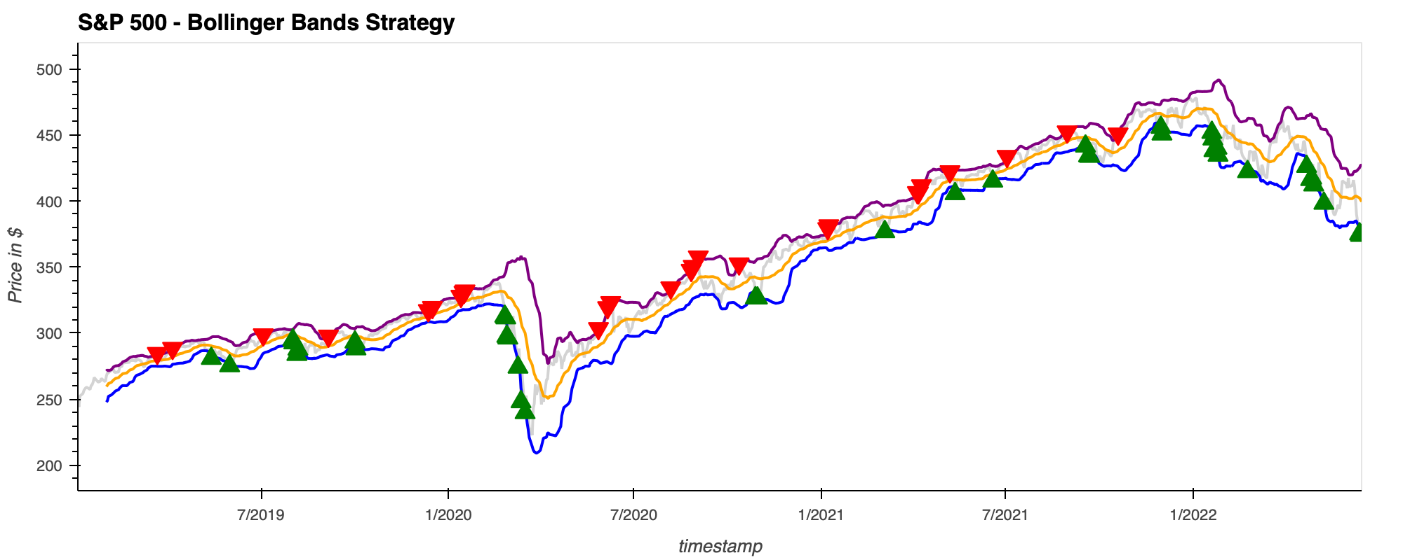
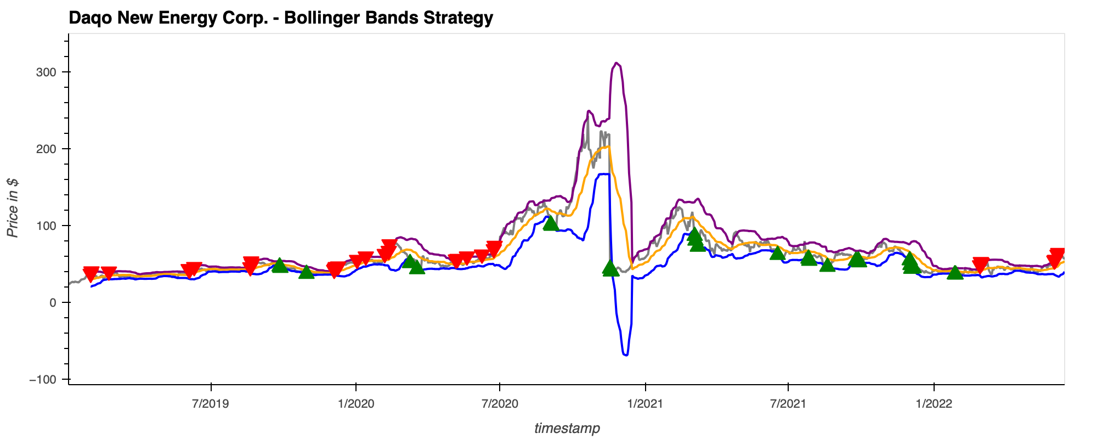
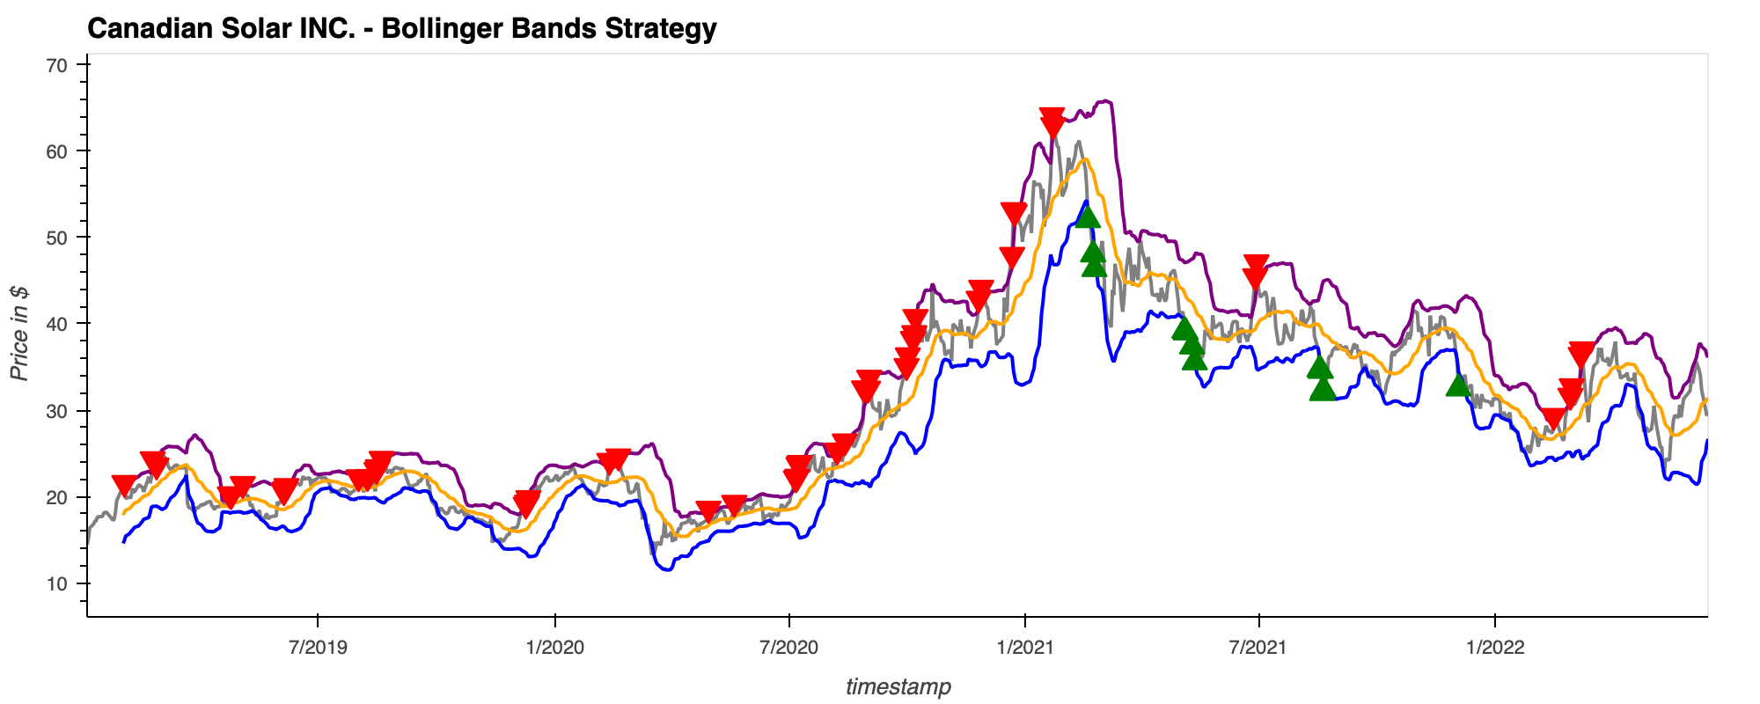
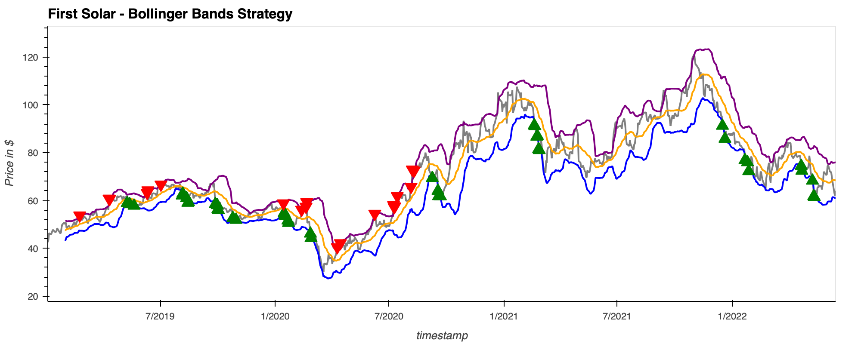
Project analysis slide 3
Algorithmic Trading
Portfolio Total: $106960
Portfolio Total: $100616
Portfolio Total: $100361
Portfolio Total: $104078

Slide 7
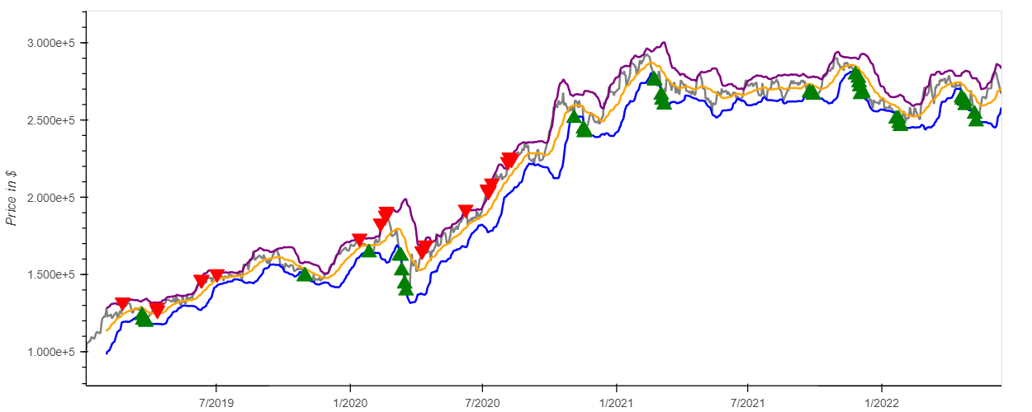
Project analysis slide 3
Algorithmic Trading
Portfolio Total: $2816781

Slide 8
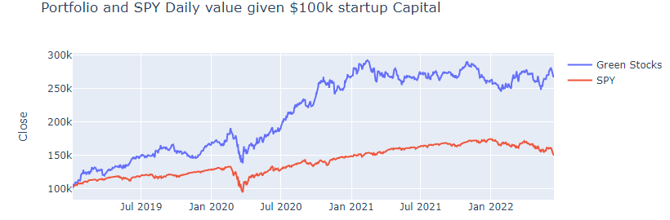
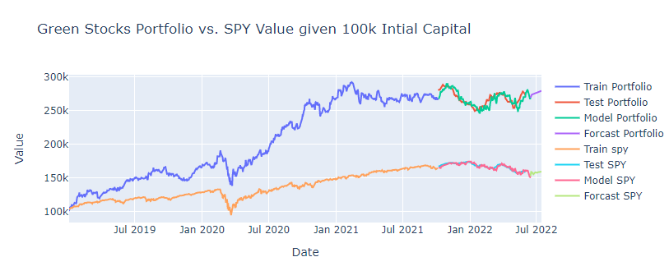
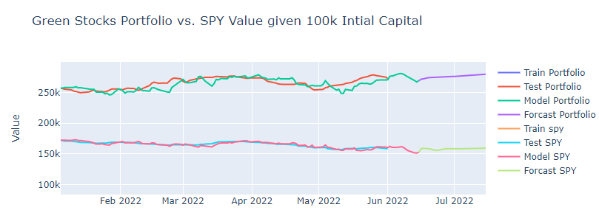
Project analysis slide 3
Machine Learning
Green Stocks outperforming SP500
LSTM I One level Sequential Model I Window of 10 days

Slide 9
Project analysis slide 2
Key Takeaways
EXPLORATION
Since 2019 green stocks perform better than SP500. Key drivers: increase in projects in the solar industry, post covid recovery, impact of Russia – Ukraine conflict
ALGO
TRADING
Green Energy stocks double the profit vs SP500 driven by SEDG
MACHINE LEARNING
Based on the LSTM simple model that was implemented, Green Stocks are expected to continue to outperform the SP500
NEXT STEPS
Consider more variables for this LSTM model and explore alternatives ML models to predict the performance of the portfolio vs SP500

Slide 10
Thank You

